Slide 1

PYTHON FOR DATA SCIENCE
PROJECT: ISL to voice

Slide 2
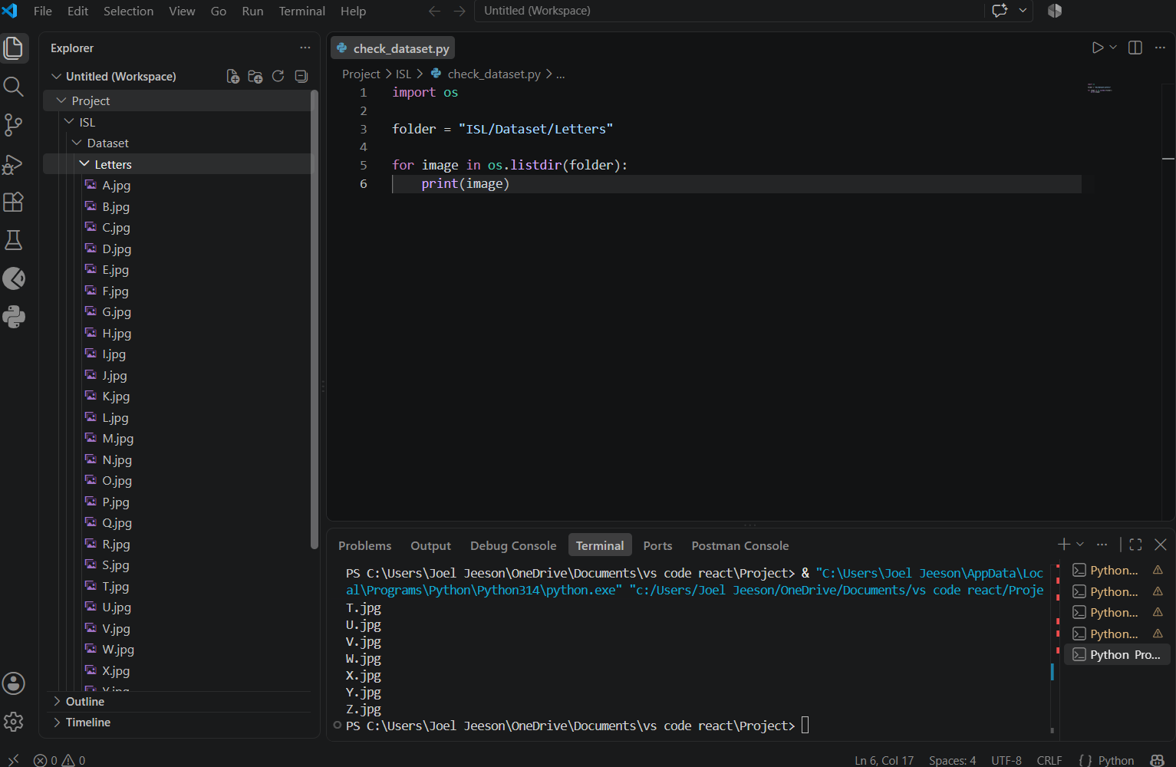
OS
Os.lsitdir(file path)
this is used to show all the conents inside the list

Slide 3
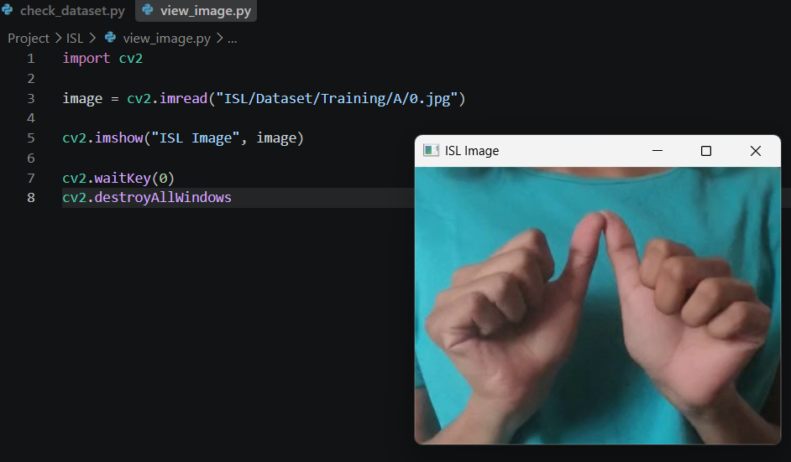
This is where we start using open cv
Here using imread we read the image
Imshow:
it opens a window with the image that is opened with imread()
Imwaitkey()
imwaitkey is used to close the window of the image after particular seconds
Syntax
cv2.waitKey(milliseconds)
So eg
cv2.waitKey(5000) means it waits 5 seconds before closing the file
But we use imwaitkey(0)
it means it waitss forever until the user presses key
- Neil Armstrong

